Slide 1
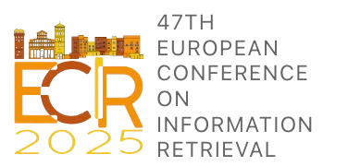
Human Experts vs. Large Language Models: Evaluating Annotation Scheme and Guidelines Development for Clinical Narratives
Text2Story 2025
Eighth International Workshop on Narrative Extraction from Texts
Ana Luísa Fernandes, Purificação Silvano, Nuno Guimarães, Rita Rb-Silva,
Tahsir Ahmed Munna, Filipe Cunha, António Leal, Ricardo Campos e Alípio Jorge
Notes:
Good morning! I’m excited to present our work on Human Experts vs. Large Language Models: Evaluating Annotation Scheme and Guidelines Development for Clinical Narratives in the Text2Story 2025 workshop. This work sits at the intersection of annotation practices, clinical NLP, and generative AI.

Slide 2
1. Introduction
Notes:
Let’s start with a bit of context.

Slide 3
1.1. Motivation
EHRs: large volumes of unstructured text, posing challenges for organization, management, and reuse in clinical and research settings (Irrera et al. 2024).
NLP techniques: key to automating the retrieval, processing, and extraction of relevant biomedical data (Irrera et al. 2024).
Advances in NLP: high-performance information extraction, but creating quality annotated corpora for model training and evaluation is a major challenge (Zhu et al. 2024).
High-quality datasets: requirement of a robust annotation scheme that accurately captures the unique characteristics of clinical text with precision and completeness.
Notes:
Electronic health records are a goldmine of data, but most of them are in unstructured, free-text form.
This makes it incredibly rich but also very challenging for organization and management, as well as for using this data for clinical and research purposes. In this context, NLP techniques are key to automating the retrieval, processing, and extracting of relevant medical information. But to train good models, we need good annotated data, and to have high-quality annotated datasets, robust annotation schemes are required so that medical information can be fully and comprehensively represented.

Slide 4
1.1. Motivation
Most clinical NLP research has focused on English, with Chinese as the second most studied language (Zhu et al. 2023). Efforts for other languages remain significantly limited.
i2b2 (Sun et al. 2013) THYME) (Styler 2014) | Event and temporal relation annotations (ISO TimeML
MERLOT (Miranda-Escalada, 2015) | Comprehensive semantic annotation framework for clinical documents in French.
Patel et al. (2018) | Large corpus of clinical documents with 11 semantic groups mapped to UMLS.
For Portuguese, annotation efforts remains particularly limited.
SemClinBr (Oliveira et al. 2022) | Annotated clinical corpus for Brazilian Portuguese, with UMLS semantic types.
Lopes et al. (2019) | Clinical text collection in European Portuguese with entities manually annotated
MediAlbertina (Nunes et al. 2024) | BERT-based encoder pre-trained on European Portuguese EMR.
Notes:
Over the years, there’ve been some annotation efforts to develop annotated clinical data—think i2b2, THYME, MERLOT—but most of these are in English. And while some work has been done for Portuguese, it’s still limited—especially when it comes to temporal information.
So, our goal is to develop and evaluate annotation schemes focused on time in clinical narratives and test how humans compare with LLMs, in building those schemes.

Slide 5


1.1. Motivation
Designing an Annotation Scheme for Clinical Narratives
Complex Task: requires expertise in both linguistics and the medical domain.
Role of LLMs: increasing use of automated and generative methods for data annotation.
Performance: LLMs can compete with human annotators but struggle with complex tasks.
Research Gap: no prior studies on LLMs developing annotation schemes for temporal information in clinical narratives.
Notes:
Designing annotation schemes for clinical narratives is a complex, interdisciplinary task that mixes linguistic theory with domain expertise in medicine. Now, LLMs like ChatGPT are being used for everything these days—including annotation. But can they design schemes and guidelines from scratch? That’s our key question.

Slide 6
1.2. Main objectives and Contributions
Comparison of human- and LLM-generated annotation schemes and guidelines through an experimental framework.
Performance Assessment of LLMs: Evaluation of the capability of an LLM to generate an annotation scheme and corresponding guidelines, with a specific focus on temporal information in clinical narrative.
Comparative Analysis: Systematic comparison between human-generated and LLM-generated annotation schemes, assessing their efficiency, consistency, and applicability.
Multilingual Expansion: The evaluation of LLM performance will be extended to Portuguese, broadening the understanding of their capabilities across languages.
Notes:
So, we had three main objectives:
1. Assess whether an LLM can generate a usable annotation scheme and guidelines.
2. Compare human vs. LLM outputs for quality and consistency.
3. Extend the study to LLM capabilities to Portuguese,

Slide 7
2.The study
Methodology
Notes:
Let’s break down what we did to achieve these objectives, starting with methodology.

Slide 8



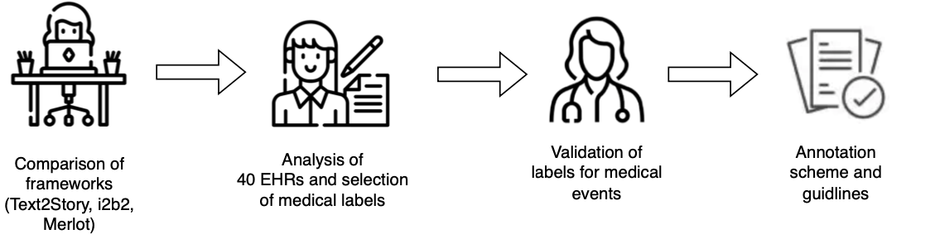
2.1. Developing temporal annotation schemes and guidelines for clinical narratives
By Human
Figure 1. Overview of the annotation scheme development process followed by a human expert
Notes:
The human-designed annotation scheme was developed by a specialist with expertise in linguistics and pharmaceutical sciences. The process began with a comparative analysis of three established frameworks: Text2Story, i2b2, and MERLOT. Text2Story—built on ISO 24617 and tailored for morphosyntactic and semantic annotation in Portuguese news texts—was informative but lacked clinical specificity. i2b2 and MERLOT, while rich in medical domain labels, were too broad to offer fine-grained distinctions. To refine the scheme, six anonymized clinical reports from patients with Acute Myeloid Leukemia were annotated using all three frameworks. The results helped pinpoint gaps, especially in domain-specific coverage. This informed a second phase using a broader corpus of 40 clinical reports—admission notes, discharge summaries, and general reports—all from the IPO-Porto hospital. Working alongside a clinical expert, the team identified missing concepts, validated key clinical elements, and used the UMLS Metathesaurus to define semantic classes.

Slide 9

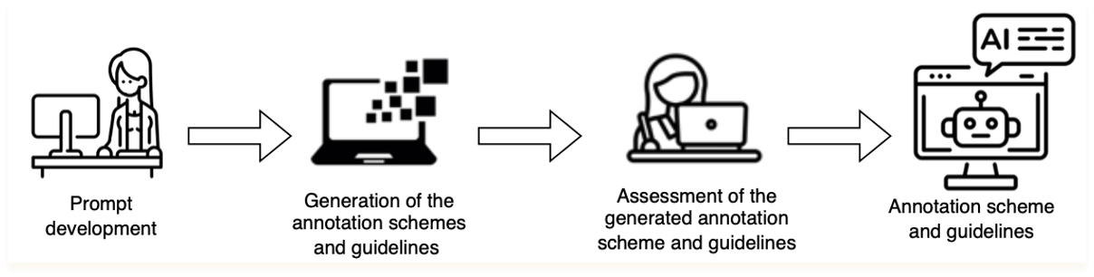
2.1. Developing temporal annotation schemes and guidelines for clinical narratives
By LLM
Figure 2. Overview of the annotation scheme development process followed by a LLM
Notes:
Then, we gave an LLM, Gemini, a similar task .We designed a series of prompts—each increasingly detailed—and asked the LLM to output a full scheme and guidelines.

Slide 10
2.1. Developing temporal annotation schemes and guidelines for clinical narratives
By LLM
Prompt | Content
Prompt 1 | Development of a temporal annotation scheme capturing morphosyntactic, grammatical, and medical domain-specific information.
Prompt 2A | Same as Prompt 1, + T2S guidelines + instructions to capture morphosyntactic and grammatical information.
Prompt 2B | Same as Prompt 2A + request to include tags specific to the medical domain.
Prompt 3A | Same as Prompt 2B + inclusion of synthetic reports as examples.
Prompt 3B | Same as Prompt 3A + an emphasis on deriving examples from synthetic reports + providing detailed specifications of markables
Table 1. Summary of the prompts content.
Notes:
This ranged from generic prompts to ones including example reports and requests for specific markables.

Slide 11
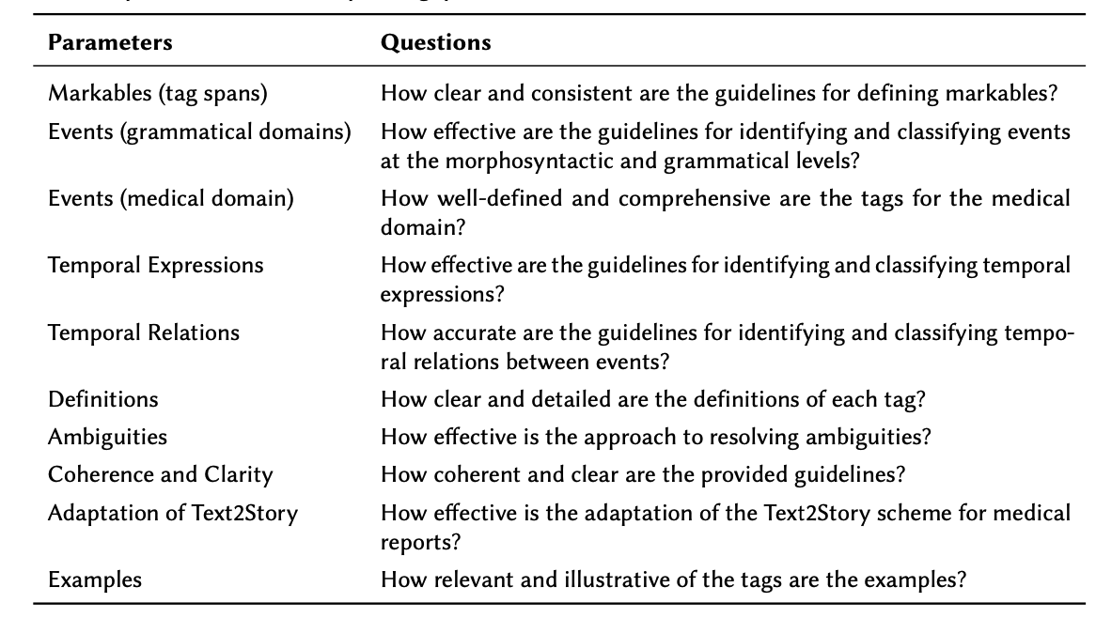
2.1. Developing temporal annotation schemes and guidelines for clinical narratives
Table 2. Evaluation parameters and corresponding questions
Notes:
to assess clarity, structure, and usefulness of the prompt outputs, we used Likert-scale evaluations (1 to 5).

Slide 12
2.1. Developing temporal annotation schemes and guidelines for clinical narratives
By LLM
Prompt | Content | Evaluation
 |  | x̄ | σ
Prompt 1 | Development of a temporal annotation scheme capturing morphosyntactic, grammatical, and medical domain-specific information. | 2.1 | 0.74
Prompt 2A | Same as Prompt 1, + T2S guidelines + instructions to capture morphosyntactic and grammatical information. | 2.7 | 1
Prompt 2B | Same as Prompt 2A + request to include tags specific to the medical domain. | 3 | 1
Prompt 3A | Same as Prompt 2B + inclusion of synthetic reports as examples. | 2.8 | 0.84
Prompt 3B | Same as Prompt 3A + an emphasis on deriving examples from synthetic reports + providing detailed specifications of markables | 3.2 | 0.63
Table 1. Means and standard deviations of the results obtained from evaluating each Prompt’s output using Likert-scales.
Notes:
You’ll notice that scores gradually improve with prompt sophistication—topping out at 3.2. Since the best result of the annotation scheme and guidelines was with prompt 3B, we used this output to conduct our experiment

Slide 13
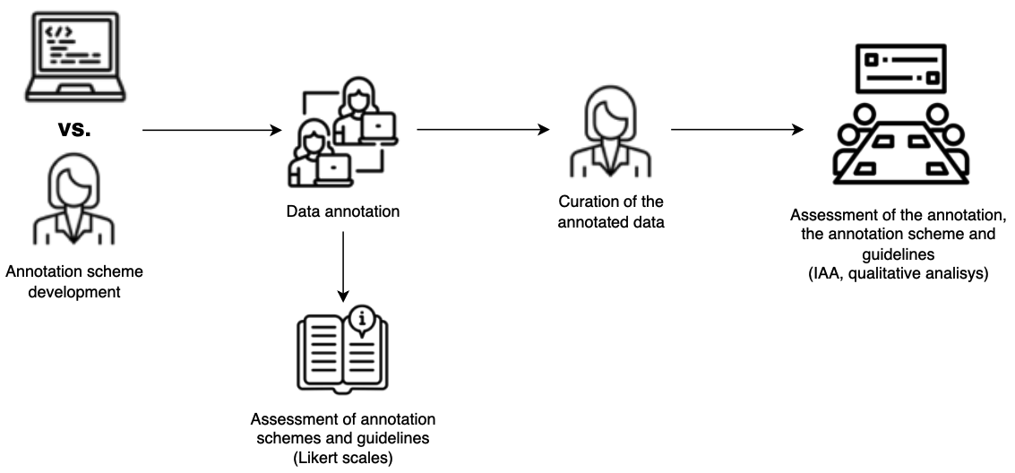
2.2. Evaluation setup
Figure 3. Overview of the two evaluation approaches used to assess the efficacy of the two annotation schemes
Notes:
So, what was the experiment setup aimed at comparing human vs. LLM outputs? To evaluate both the human- and LLM-generated annotation schemes, we used a two-part assessment strategy.
First, we conducted a manual annotation task using clinical reports. Two experienced linguistics students annotated the data using both sets of guidelines. To avoid bias, each annotator started with a different scheme and patient, then switched—ensuring balanced exposure. The reports themselves were synthetic clinical records created by a physician from IPO-Porto, representing two patients diagnosed with Acute Myeloid Leukemia. Each patient had an admission report, two discharge summaries, and a general medical report. Annotations were then curated by a domain expert to check for accuracy and proper guideline application. All tasks were performed in the INCEpTION annotation platform, and annotation consistency was measured using inter-annotator agreement (IAA).
Second, to evaluate the clarity and usability of the guidelines, we reused the Likert-scale assessment previously applied to LLM prompt outputs. This time, the annotators themselves scored the schemes based on their annotation experience—giving us direct insights into guideline effectiveness.

Slide 14
2.The study
Results and Discussion

Slide 15
4. Results
Human annotation – IAA
 | Span-Level | Label Agreement | Attribute Agreement (Medical Domain)
Human Expert Scheme | 72% | 81% | 85%
LLM Scheme | 64% | 78% | 61%
Table 3. Results of the IAA
Notes:
Here are the IAA scores. The human-designed scheme had higher agreement across the board—especially in domain-specific attributes, where the LLM struggled. Notably, human annotators reached 85% agreement on medical domain attributes using the human scheme but only 61% with the LLMs.

Slide 16
4. Results
Likert-scale performance assessment tool
Annotators | Evaluation
 | Human |  | LLM
 | x̄ | σ | x̄ | σ
Annotator 1 | 4.1 | 0.7 | 1.8 | 0.4
Annotator 2 | 4.5 | 0.5 | 2.5 | 0.8
Table 4. Means and standard deviations of the results obtained from the evaluation of the schemes/guidelines developed by LLM (Prompt 3B and by Human)
Notes:
Annotators rated the human-developed guidelines at around 4.1–4.5 out of 5, while the LLM-generated ones ranged from 1.8 to 2.5. So, while the LLM tried its best, according to our annotators, its guidelines just didn’t provide the same level of clarity or consistency.

Slide 17



4. Results
Human annotation – Curation
Findings – Human Expert Scheme
Clear identification of events and temporal expressions.
Minor inconsistencies in medical domain attributes (likely due to annotators' lack of expertise).
Temporal relation types were a main source of variance.
Annotators sometimes ignored rules on arrow directionality, despite being specified.
Findings – LLM-Generated Scheme
Several inconsistencies observed.
Unclear guidelines led to diverging interpretations:
One annotator used morphosyntactic/grammatical categories, the other did not.
No rules on arrow directionality, increasing variance.
Notes:
The curation of the data annotated according to the human and LLm-generated scheme enabled some conclusions.
First, the human guidelines weren’t flawless, of course. Annotators still disagreed on aspects like temporal relation directionality—but crucially, those rules were there, even if occasionally ignored. However, there was a clear identification of events and temporal expressions.
What about the annotation generated by LLM? What Went Wrong for the LLM?
Some key issues were the following:
- Inconsistent definitions and unclear instructions, which led to different interpretations by annotators.
- Lack of information regarding different elements of the annotation like the directionality rules for temporal relations
- Basically, the LLM didn’t always know what mattered or how to structure it, and that was reflected in the annotations.

Slide 18
3.Conclusion and Future work

Slide 19

3.1. Conclusion
Human vs LLM:
the best performance in the development of annotation schemes and guidelines?
Although LLMs are capable of creating annotation guidelines, the guidelines
produced by a human expert were more comprehensible, coherent, and clear.
Notes:
So what did we learn about Human vs LLM-generated annotation schemes?
- LLMs can draft annotation schemes, sure—but with poor quality.
- Prompt engineering improves outputs, but it doesn’t solve everything.
- Human-crafted schemes still deliver better structure, clarity, and usability—at least for now.
Humans still lead when it comes to creating annotation guidelines that are clear, coherent, and applicable

Slide 20
3.2. Future Work
In-depth analysis of human annotation results, with a focus on annotator disagreement.
Identification of factors contributing to discrepancies and refinement of the annotation scheme.
Integration of automated evaluation metrics to complement manual assessments.
Focus on readability, clarity, and structural coherence.
Inclusion of a wider range of LLMs, including open-source alternatives.
Expansion of the study to additional annotation layers, especially the referential layer.
Goal: systematically capture participants and their relationships.
Notes:
So where do we go from here?
We’ll dive deeper into annotator disagreement—what causes it, and how we can reduce it. We are just now finishing up a paper about this issue.
Integration of automated evaluation metrics to complement manual assessments. Focus on readability, clarity, and structural coherence.
We plan to expand to more LLMs, especially open-source ones.
And we’re looking at additional layers, like referential annotation, to understand relationships between participants in clinical events.

Slide 21
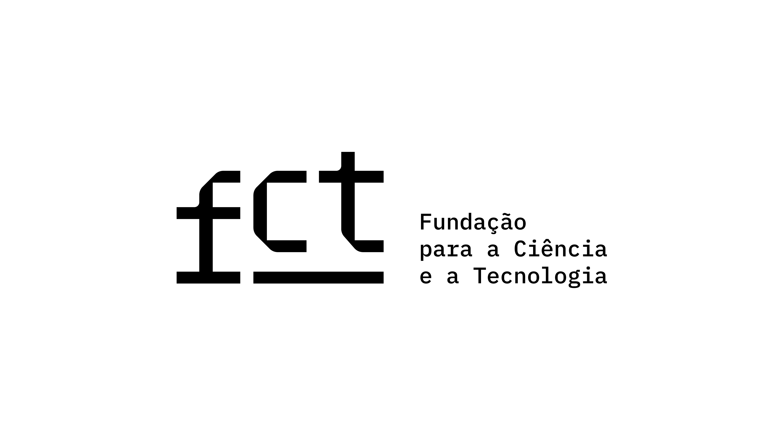

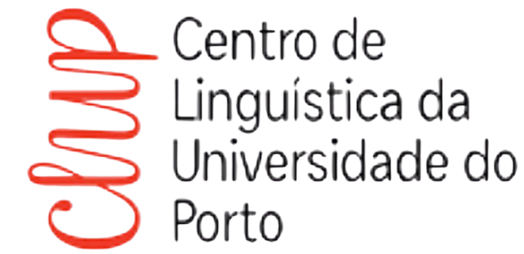



Thank you!
This research was partially funded by National Funds through the FCT - Fundação para a Ciência e a Tecnologia, I.P. (Portuguese Foundation for Science and Technology) within the project StorySense, with reference 2022.09312.PTDC (DOI 10.54499/2022.09312.PTDC) and by the Centre of Linguistics of the University of Porto, within the project UIDB/00022.
Notes:
If we’d like to know more about our work, you can find our paper with this qr code.
Thank you so much for your attention. I’m happy to take any questions, critiques you might have.

Slide 22
References
[1] O. Irrera, S. Marchesin, G. Silvello, Metatron: Advancing biomedical annotation empowering relation annotation and collaboration, BMC Bioinformatics 25 (2024) 1–41. doi:10.1186/
s12859-024-05730-9.
[2] C. Lindvall, C.-Y. Deng, E. Moseley, N. Agaronnik, A. El-Jawahri, M. K. Paasche-Orlow, J. R. Lakin, A. Volandes, J. A. Tulsky, Natural language processing to identify advance care planning
documentation in a multisite pragmatic clinical trial, Journal of Pain and Symptom Management 63 (2022) e29–e36. doi:10.1016/j.jpainsymman.2021.06.025.
[3] E. Zhu, Q. Sheng, H. Yang, Y. Liu, T. Cai, J. Li, A unified framework of medical information annotation and extraction for chinese clinical text, Artificial Intelligence in Medicine 142 (2023) 1–12. doi:10.1016/j.artmed.2023.102573.
[4] N. Ide, Introduction: The handbook of linguistic annotation, in: N. Ide, J. Pustejovsky (Eds.), Handbook of Linguistic Annotation, Springer, Dordrecht, 2017, pp. 1–18.
[5] G. Moharasan, T.-B. Ho, Extraction of temporal information from clinical narratives, Journal of Healthcare Informatics Research 3 (2019) 220–244. doi:10.1007/s41666-019-00049-0.
[6] O. Bodenreider, The unified medical language system (umls): Integrating biomedical terminology,Nucleic Acids Research 32 (2004) D267–D270. doi:10.1093/nar/gkh061.
[7] Z. Tan, D. Li, S. Wang, A. Beigi, B. Jiang, A. Bhattacharjee, M. Karami, J. Li, L. Cheng, H. Liu, Large language models for data annotation and synthesis: A survey, 2024. URL: https://arxiv.org/abs/ 2402.13446. arXiv:2402.13446.
[8] A. H. Nasution, A. Onan, Chatgpt label: Comparing the quality of human-generated and llm-generated annotations in low-resource language nlp tasks, IEEE Access 12 (2024) 71876–71900. doi:10.1109/ACCESS.2024.3402809.
[9] N. Pangakis, S. Wolken, N. Fasching, Automated annotation with generative ai requires validation, 2023. URL: https://arxiv.org/abs/2306.00176. arXiv:2306.00176.
[10] A. Roberts, R. J. Gaizauskas, M. Hepple, G. Demetriou, Y. Guo, I. Roberts, A. Setzer, Building a semantically annotated corpus of clinical texts, Journal of biomedical informatics 42 5 (2009) 950–66. URL: https://api.semanticscholar.org/CorpusID:17473913.
[11] P. Patel, D. Davey, V. Panchal, P. Pathak, Annotation of a large clinical entity corpus, in: E. Riloff, D. Chiang, J. Hockenmaier, J. Tsujii (Eds.), Proceedings of the 2018 Conference on Empirical Meth-ods in Natural Language Processing, Association for Computational Linguistics, Brussels, Belgium, 2018, pp. 2033–2042. URL: https://aclanthology.org/D18-1228/. doi:10.18653/v1/D18-1228.
[12] W. F. Styler IV, S. Bethard, S. Finan, M. Palmer, S. Pradhan, P. C. de Groen, B. Erickson, T. Miller, C. Lin, G. Savova, J. Pustejovsky, Temporal annotation in the clinical domain, Transactions of the Association for Computational Linguistics 2 (2014) 143–154. URL: https://aclanthology.org/ Q14-1012/. doi:10.1162/tacl_a_00172.
[13] W. Sun, A. Rumshisky, O. Uzuner, Annotating temporal information in clinical narratives, Journal of Biomedical Informatics 46 (2013) S5–S12. URL: https://doi.org/10.1016/j.jbi.2013.07.004. doi:10. 1016/j.jbi.2013.07.004.
[14] International Organization for Standardization, Iso 24617:2012 - language resource management – semantic annotation framework, 2012.
[15] D. Albright, A. Lanfranchi, A. Fredriksen, I. WilliamF.Styler, C. Warner, J. D. Hwang, J. D. Choi, D. Dligach, R. D. Nielsen, J. H. Martin, W. H. Ward, M. Palmer, G. K. Savova, Towards comprehensive syntactic and semantic annotations of the clinical narrative, Journal of the American Medical Informatics Association : JAMIA 20 (2013) 922 – 930. URL: https://api.semanticscholar.org/CorpusID: 15409975.
[16] A. Miranda-Escalada, M. López-Arevalo, J. Armengol-Estapé, M. T. Martín-Valverde, F. Sanz, L. I. Furlong, M. Krallinger, A clinical gold standard corpus in spanish: Mining adverse drug reactions, Journal of Biomedical Informatics 56 (2015) 318–332. URL: https://doi.org/10.1016/j.jbi.2015.06.016. doi:10.1016/j.jbi.2015.06.016.
[17] L. Campillos, L. Deléger, C. Grouin, T. Hamon, A.-L. Ligozat, A. Névéol, A french clinical corpus with comprehensive semantic annotations: Development of the medical entity and relation limsi annotated text corpus (merlot), Language Resources and Evaluation 52 (2018) 571–601. URL: https://doi.org/10.1007/s10579-017-9382-y. doi:10.1007/s10579-017-9382-y.

Slide 23
References
[18] J. V. A. d. Souza, Y. B. Gumiel, L. E. S. e. Oliveira, C. M. C. Moro, Named entity recognition for clinical portuguese corpus with conditional random fields and semantic groups, in: Simpósio Brasileiro de Computação Aplicada à Saúde (SBCAS), 2019, pp. 318–323. URL: https://doi.org/10.5753/sbcas.2019.6269. doi:10.5753/sbcas.2019.6269.
[19] L. E. S. e. Oliveira, A. C. Peters, A. M. P. da Silva, C. P. Gebeluca, Y. B. Gumiel, L. M. M. Cintho, D. R. Carvalho, S. Al Hasan, C. M. C. Moro, Semclinbr—a multi-institutional and multi-specialty semantically annotated corpus for portuguese clinical nlp tasks, Journal of Biomedical Semantics 13 (2022) 13. URL: https://doi.org/10.1186/s13326-022-00269-1. doi:10.1186/s13326-022-00269-1.
[20] N. C. Rocha, A. M. P. Barbosa, Y. O. Schnr, J. Machado-Rugolo, L. G. M. de Andrade, J. E. Corrente, L. V. de Arruda Silveira, Natural language processing to extract information from portuguese- language medical records, Data 8 (2023) Article 1. URL: https://doi.org/10.3390/data8010011. doi:10.3390/data8010011.
[21] F. Lopes, C. Teixeira, H. Gonçalo Oliveira, Contributions to clinical named entity recognition in portuguese, in: D. Demner-Fushman, K. B. Cohen, S. Ananiadou, J. Tsujii (Eds.), Proceedings of the 18th BioNLP Workshop and Shared Task, Association for Computational Linguistics, 2019, pp. 223–233. URL: https://doi.org/10.18653/v1/W19-5024. doi:10.18653/v1/W19-5024.
[22] M. Nunes, J. Boné, J. C. Ferreira, P. Chaves, L. B. Elvas, Medialbertina: An european portuguese medical language model, Computers in Biology and Medicine 182 (2024) 109233. URL: https://doi.org/10.1016/j.compbiomed.2024.109233. doi:10.1016/j.compbiomed.2024.109233.
[23] P. Silvano, A. Leal, F. Silva, I. Cantante, F. Oliveira, A. Jorge, Developing a multilayer semantic annotation scheme based on ISSO standards for the visualization of a newswire corpus, in: H. Bunt (Ed.), Proceedings of the 17th Joint ACL - ISO Workshop on Interoperable Semantic Annotation, Association for Computational Linguistics, Groningen, The Netherlands (online), 2021, pp. 1–13. URL: https://aclanthology.org/2021.isa-1.1/.
[24] A. Leal, P. Silvano, E. Amorim, I. Cantante, F. Silva, A. Jorge, R. Campos, The place of iso-space in text2story multilayer annotation scheme, in: H. Bunt (Ed.), Proceedings of the 18th Joint ACL- ISO Workshop on Interoperable Semantic Annotation within LREC2022, European Language Resources Association, 2022, pp. 61–70. URL: https://aclanthology.org/2022.isa-1.8.
[25] P. Silvano, E. Amorim, A. Leal, I. Cantante, F. d. Silva, A. Jorge, R. Campos, S. S. Nunes, Annotation and visualisation of reporting events in textual narratives, in: Proceedings of Text2Story 2023: Sixth Workshop on Narrative Extraction From Texts, CEUR Workshop Proceedings, Dublin, Ireland, 2023, pp. 47–59.
[26] P. Silvano, E. Amorim, A. Leal, I. Cantante, A. Jorge, R. Campos, N. Yu, Untangling a web of temporal relations in news articles, in: Proceedings of Text2Story - Seventh Workshop on Narrative Extraction From Texts Held in Conjunction with the 46th European Conference on Information Retrieval (ECIR 2024), 2024, pp. 77–92. URL: https://repositorio-aberto.up.pt/handle/10216/158767.
[27] M. A. Leite, Ontology-Based Extraction and Structuring of Narrative Elements from Clinical Texts, Mater´s thesis, Universidade do Porto, 2024.
[28] S. Sheikholeslami, M. Meister, T. Wang, A. H. Payberah, V. Vlassov, J. Dowling, Autoablation: Automated parallel ablation studies for deep learning, in: Proceedings of the 1st Workshop on Machine Learning and Systems, 2021, pp. 55–61. URL: https://doi.org/10.1145/3437984.3458834. doi:10.1145/3437984.3458834.
[29] R. Likert, A technique for the measurement of attitudes, Archives of Psychology, Nova Iorque, 1932.
[30] J.-C. Klie, M. Bugert, B. Boullosa, R. Eckart de Castilho, I. Gurevych, The inception platform: Machine-assisted and knowledge-oriented interactive annotation, in: D. Zhao (Ed.), Proceedings of the 27th International Conference on Computational Linguistics: System Demonstrations, Association for Computational Linguistics, 2018, pp. 5–9. URL: https://aclanthology.org/C18-2002.
[31] R. Artstein, Inter-annotator agreement, in: N. Ide, J. Pustejovsky (Eds.), Handbook of Linguistic Annotation, Springer Netherlands, 2017, pp. 297–313. URL: https://doi.org/10.1007/978-94-024-0881-2_11. doi:10.1007/978-94-024-0881-2_11.

Slide 24
Human Experts vs. Large Language Models: Evaluating Annotation Scheme and Guidelines Development for Clinical Narratives
Text2Story 2025
Eighth International Workshop on Narrative Extraction from Texts
Ana Luísa Fernandes, Purificação Silvano, Nuno Guimarães, Rita Rb-Silva,
Tahsir Ahmed Munna, Filipe Cunha, António Leal, Ricardo Campos e Alípio Jorge

Slide 25
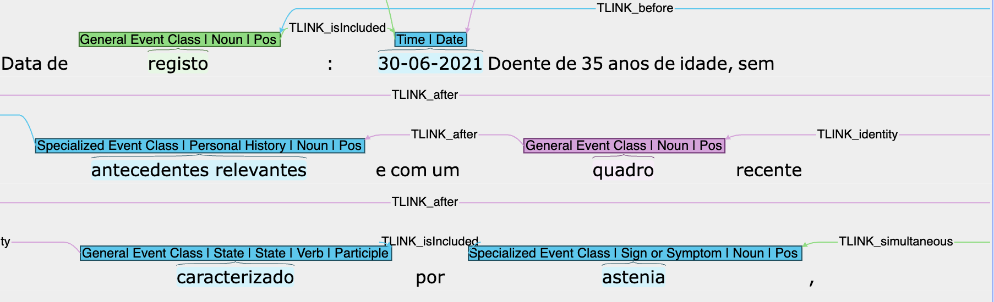
What is an annotation scheme?
Descriptive and analytical labels assigned to linguistic data based on predefined guidelines;
These specify labels, features, annotation units, and procedures;
Clear operational definitions ensure consistency among annotators;
In machine learning, schemes may highlight features linked to labels.
Figure 1. Example of an annotated medical report

Slide 26
